Slide 1
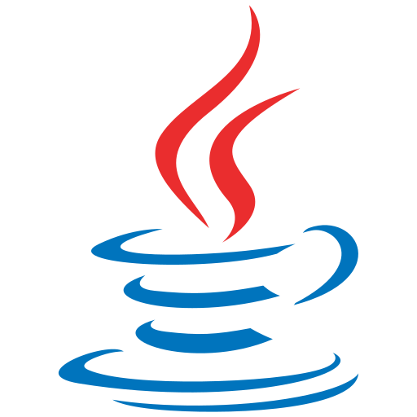
Introduction to JAVA
Tech Club (GNIOT)

Slide 2
Java
Java is a programming language.
JAVA is developed in year 1995 by Sun Microsystems
Later on it is owned by Oracle Corporation.
It is used for:
Mobile applications (specially Android apps)
Web and Desktop applications
Web servers and application servers
Games
Database connection
And much, much more!

Slide 3
Why Java came into Existence?
At that time the existing programming languages like C++ had its
emphasis on speed, not reliability.

Slide 4
Advantages of Java
Java works on different platforms (Windows, Mac, Linux, Raspberry Pi, etc.)
It is one of the most popular programming language in the world
It is easy to learn and simple to use
It is open-source and free
It is secure, fast and powerful
It has a huge community support (tens of millions of developers)
Java is an object oriented language which gives a clear structure to programs and allows code to be reused, lowering development costs
As Java is close to C++ and C#, it makes it easy for programmers to switch to Java or vice versa

Slide 5
Features of Java.
Simple
Object-Oriented
Portable
Platform independent
Secured
Robust
Interpreted
High Performance
Multithreaded

Slide 6
Platform Independent
WORA/WORE :- Write Once Run Anywhere, Write Once Run Everywhere.
Ideally, this meant that a Java program could be developed on any device, compiled into standard bytecode, and be expected to run on any device equipped with a Java virtual machine (JVM). The installation of a JVM or Java interpreter on chips, devices, or software packages became an industry standard practice.
JAVA is platform independent but the JVM is platform dependent.

